Slide 1
Path Following &Path Planning (MPC) Model Predictive Control
J. B. Rawlings and D. Q. Mayne, “Model Predictive Control: Theory and Design”, Madison, WI: Nob Hill Publishing, 2009.
F. Borrelli, A. Bemporad, and M. Morari, “Predictive Control for Linear and Hybrid Systems”, Cambridge, UK: Cambridge University Press, 2017.
D. Q. Mayne, J. B. Rawlings, C. V. Rao, and P. O. M. Scokaert, "Constrained model predictive control: Stability and optimality,“ vol. 36, no. 6, pp. 789-814, Jun. 2000, doi: 10.1016/S0005-1098(99)00214-9.

Slide 2
Path Planning
Path planning is a process in robotics and processing that searches for the optimal path from the starting point to the destination point, avoiding obstacles and considering certain obstacles. This is critical in the development of autonomous vehicles, robots, and navigation systems

Slide 3
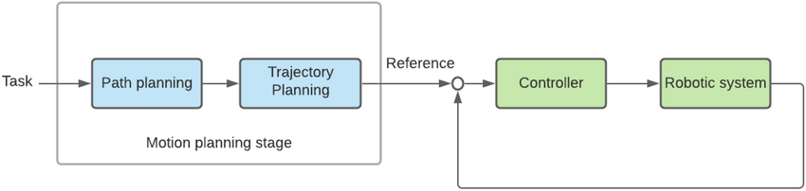
Path Planning Structure

Slide 4
How Path Planning Works
A robot or navigation system first needs to understand its surroundings. This can be done through sensors such as lidar, cameras, or ultrasonic scanners. Data obtained from sensors is used to build a map representing the environment in the form of a grid or geometric model.
Determining Waypoints The starting location of the robot and the desired destination point are determined by the system integrated into the robot.

Slide 5
Path Following
The process in which a robot or vehicle follows a predetermined path or trajectory with high accuracy and precision. When performing path following, the vehicle uses various sensors and control systems to monitor its position relative to the desired path and correct its movement to stay on that path. This technique is important in applications such as autonomous vehicles, automated travel, and delivery robots, where precise movements are required to reach a destination safely and efficiently.

Slide 6
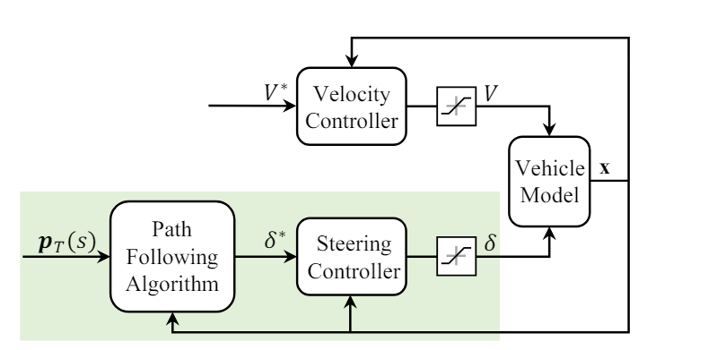
Path Following Structure

Slide 7
How Path Following Works
The path followed by a vehicle or robot is usually pre-mapped. This path can be a manually measured path, a path generated by path planning, or a path provided by the navigation system. Sensorization: Vehicles or robots are equipped with sensors that are used to monitor their position relative to the path they are following. These sensors can be lidar sensors, cameras, ultrasonic sensors, or other sensors. Environmental Perception Based on data from sensors, the vehicle or robot obtains an understanding of the surrounding environment.

Slide 8
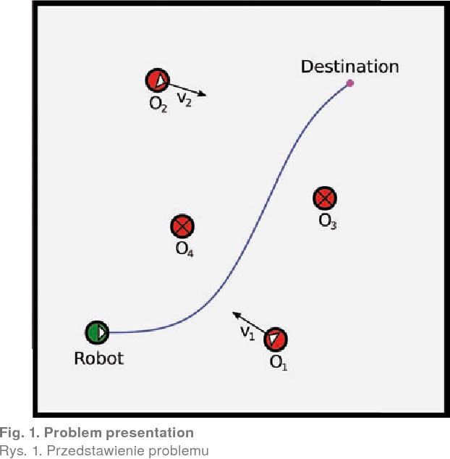
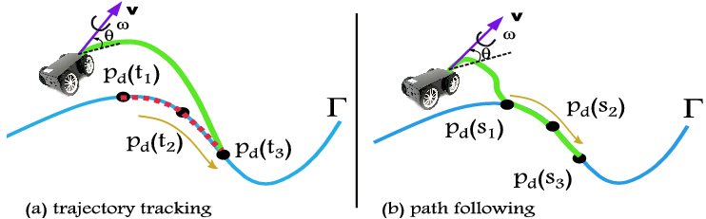
Follow the carrot (Path Planning & Following)

Slide 9
MPC (Model Predictive Control)
The MPC method is a control method used in dynamic systems to produce a series of control actions based on a predictive model of the system itself. During operation, the MPC continuously updates predictions and planning based on new information from the system. This allows the MPC to adapt its control actions according to possible changes in conditions and objectives.

Slide 10
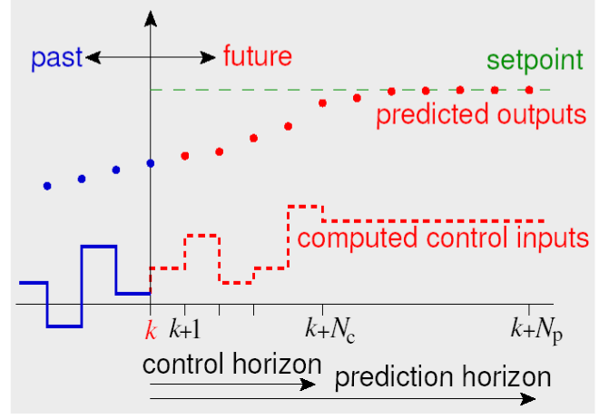
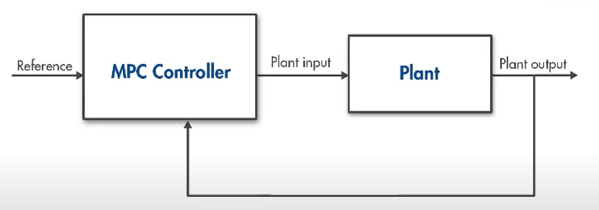
MPC Methodology & Structure

Slide 11
How MPC works
Model predictive control is a multivariable control algorithm that uses:
internal dynamic process models
cost function J on the horizon
optimization algorithm that minimizes the cost function J using control input u

Slide 12
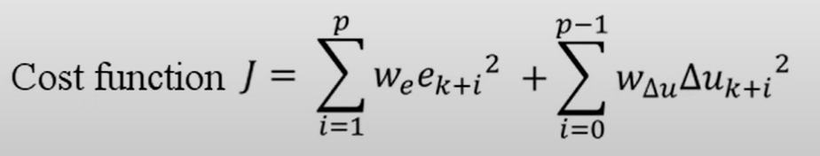
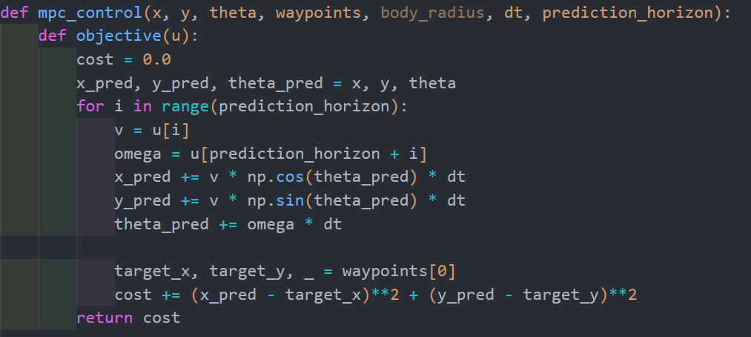

Slide 13
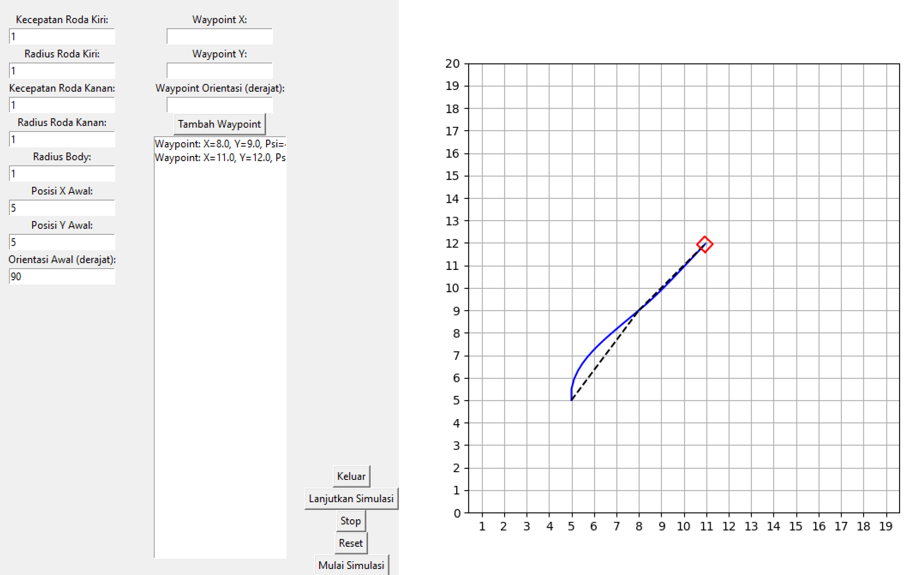
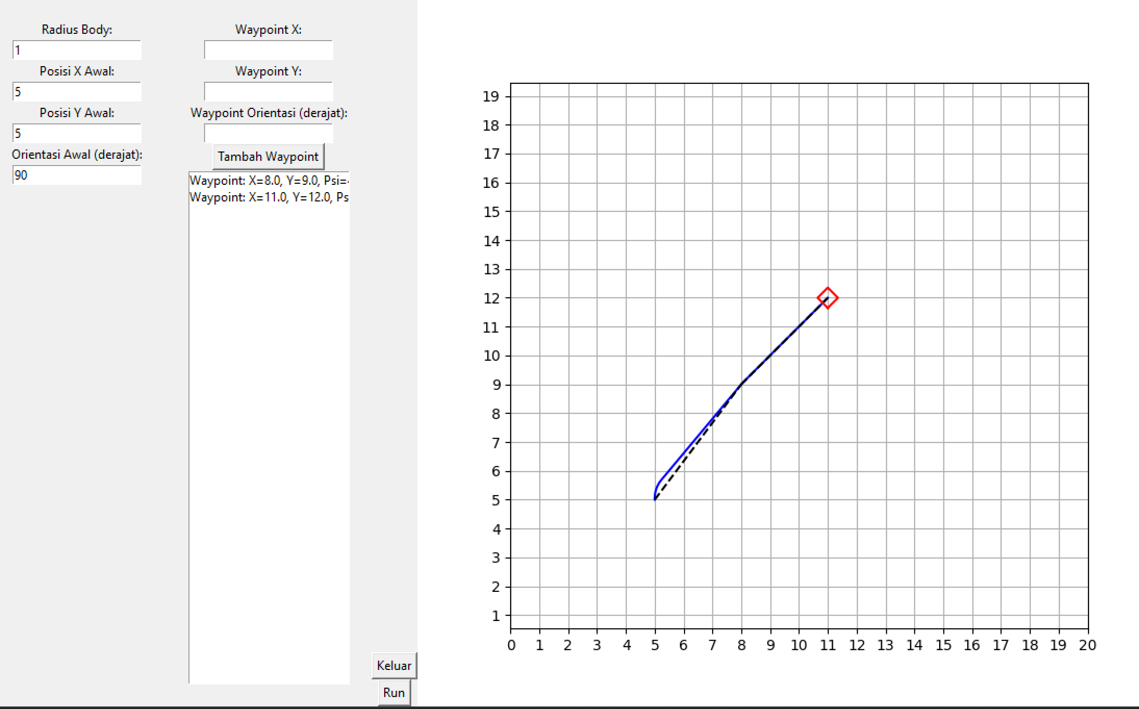
Comparison (Path Following with and without using MPC in Simulation) MPC = minimize/optimize linear and angular velocity to match the distance between the robot's predicted position and the waypoint.
Without MPC
With MPC

